Slide 1

Fundamentals of Communication and Voice Dynamics
Role and Purpose of Communication,
Types & Flow of Communication,
Barriers to Effective Communication,
7 C’s of Communication,
Code and Content; Stimulus & Response,
Vowel Sounds, Consonant Sounds,
Tone: Rising and Falling Tone

Slide 2
What exactly do we mean when we Communicate?
The English word "communication" originates from the Latin word "communicare," which can be translated as "to impart," "to participate," "to share," or "to make common." It is a process that involves the interchange of facts, ideas, and opinions, and it also serves as a way through which individuals or organisations share meaning and understanding with one another.

Slide 3

Some Famous Definitions:
According to Murphy et al “Simply stated, communication is a two-way process of exchanging ideas or information”.
American Management Association says, “Communication is any behaviour that results in an exchange of meaning”.
“Communication is the transmission and interchange of facts, ideas, feelings or course of action.” Behind Brown

Slide 4
The process of communication
Communication is a two-way process that involves both a sender and a receiver. This means that communication is an interactive activity. The sender communicates the concept by encoding it and transmitting it over a channel (language).
The receiver receives the message and decodes it. Last but not least, once the message has been comprehended, the receiver will transmit the feedback to the sender.

Slide 5

Elements of Communication Process
1. Sender: The person who encrypts the message and starts the process of communicating with the recipient.
The sender needs to have effective communication skills (SWRL), a positive attitude, confidence, abundant use of body language, a moderate tone and accent, solid subject knowledge, and so on in order for the communication to be successful.

Slide 6

2. The Message: The message is what the communicator is trying to get over to the receiver. It might be a thought, an idea, some facts, or even a feeling. The message ought to be engaging, original, reasonable, and so on.
3. Channel: The term "channel" in the field of communication refers to language. It is essential that the sender and the receiver share a shared understanding of its contents.

Slide 7

4. Receiver: The receiver is the person who is responsible for decoding the message. The receiver bears an equal share of the responsibility for the successful completion of the communication. It is important that he possesses a nature that is attentive, aware, and optimistic.
5. Feedback: It is the signal of the receiver's response to the speaker after decoding the message via verbal (by words) or non-verbal (gesture, posture, eye-contact, gestures, symbols, etc.)

Slide 8

Communication Process Cycle This process can be easily understood by the following diagram:
Encoding Decoding
Sender
Receiver
Message
Channel
Feedback

Slide 9
Role and Purpose of Communication
Communication is essential in an organization, because it serves as a medium to share the important information. People, working in a company should have a mutual understanding which can be attained by sharing knowledge.
This communication turns to be effective when researches when this process of sharing takes place. Today communication is the hub of an organization.

Slide 10
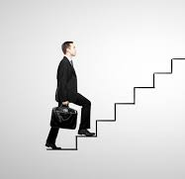
.
There are three basic objectives of communication
To inform
To instruct and
To inspire
Except these three, there are other secondary purposes of communication. The purpose may change according to the mood and intention of the speaker.

Slide 11
Purpose of Communication
1. To Boost Morale of Employees: Business Communication is made to boost the morale of the employees. It increases the productivity of the employees in his company.
2. To Achieve Goal: The goal of the organization can be obtained through effective organizational communication. Everybody tries to acquire such goal and therefore it requires effective organizational communication.

Slide 12
3. To Maintain Co-operation: Communication encourages managerial efficiency. Managerial functions like planning, control, coordination, motivation cannot be discharged without communication. As management is an art of ensuring targets and targets are achieved in collaboration with other people. Communication educates personnel working. Management communicates goals, policies and targets by issuing verbal and written instructions. The yardstick for measuring managerial efficiency is of course communication that helps in it. 4. To Plan: Planning decides what is to be done in future. All the information and data which are required to make a plan for business can be obtained or gathered through communication.
.

Slide 13
5. To Facilitate Direction and Motivation: The boss gives direction or order to his subordinate and managers need to motivate their employees to in crease the concentration and productivity. Hence, communication helps to facilitate direction and motivation.
6. To Achieve Efficiency: Communication can provide information regarding past and present. It also helps to anticipate about future. So, Communication increases efficiency of the workers by providing instant information.

Slide 14
.
7. To Improve Employer-Employee Relationship: To achieve the Organizational objectives, there must be good relationship between employee and employer. And to improve such relationship, there must be effective communication.
8. To Solve Problem: Communication can remove the gap between employees and employer. Fruitful communication ensures a network in an Organization to solve problems. Conflict arises and exists in an Organization. Fruitful communication ensures a network to solve conflict. It also removes the gap between employee and employer.

Slide 15
.
9. To Manage Human Resources: To recruit, train-up & motivate human resource properly, there must be effective communication. Skilled manpower are professional and work for achievement and development.
10. To Attract Customer: To knock the door of potential customers with new product and service of an enterprise, there should exist an efficient communication. So better communication will cause more customers and more customers will cause more profit.

Slide 16
.
11. To Future Plan: In today's modern competitive world, there is requirement of changing the plan according to environment and communication environment. This involves awareness through proper communication.
12. To Educate Workers: Communication helps the Organization to train-up the employees/workers through organized programs. For example, Orientation, workshops, film show, internship etc.

Slide 17

Technical Communication “Technical Communication is that kind of communication which is used in technical subjects”. According to Professor J. Raleigh Nelson, “Technical Communication is specialized form of exposition – a form of discourse distinguished from other forms in certain essential features.”
Joseph Racker writes, “Technical Communication involves material of a specialized nature, meant for a specific reading group.”
Precisely, Technical Communication is that branch of communication in which knowledge of a subject in particular is required along with a set kind of technical and scientific style.

Slide 18
Cont…
Salient Features of Technical Communication
COS + BUT
Wherein:
C – stands for Clarity
O – Stands for Objectivity
S – stands for Simplicity
B – stands for Brevity
U – stands for Utility
T – stands for Technical Presentation

Slide 19
1.Clarity:
The first significant and cardinal feature of scientific and Technical Communication is clarity. It mitigates and minimizes ambiguity and diffuseness. It crystallizes and shapes ideas, sentence and a paragraph. For maintaining clarity, it is absolutely prudent to have a clear – cut idea and comprehension of what we want to write or tell. Clarity of thought is interlinked with the Clarity of expression. For example:
He is a scientist as amongst others who has listened to deep humming sound of the sudden upward flight of an aircraft.
He is one of those scientists who have listened to the zooming of an aircraft.
Will you be kind enough to help me?
Kindly help me.

Slide 20
2. Objectivity:
The second salient feature of Technical Communication is objectivity. The element of “I”, which is a common note in a subjective communication, remains absent in Technical communication. We have to concentrate on facts and their general impact instead of subjective or individual findings.
I believe as others also believe that through a particular side of scientific researches, I can study the ways and manners of all human beings growing ripe, old and grey – and also their decaying processes.
It is believed that gerontology studies the processes of growing old amongst (or in) human beings.

Slide 21
3. Simplicity:
In Technical Communication, simplicity is equally important. As a matter of fact, simplicity makes the style interesting and effective. For this, a writer has to work hard to write simple sentences. One has, therefore, be quite cautious about the choice of words. Compound and complex sentences should be avoided so far as possible.
If you put a solid on heat, its temperature increases and at a certain temperature increase and at a certain temperature melts to a liquid, and on further constant temperature into the gaseous state also increase.
When a solid is heated constantly on a certain temperature, the vibrations of the molecules increase.

Slide 22
4. Brevity:
Another quality of Technical Communication is brevity. By brevity we mean briefness and shortness. A Professional does not use diffuse and round – about sentences and expressions. He has to avoid circumlocution as well as verbosity. He has to be brief, to the point, cogent and relevant. He cannot use lengthy, racy or superfluous sentences. He has to be as brief and to the point as possible.
The scientist was inspecting a large tank in which gas was stored
The scientist was inspecting the gasoline.
We are enclosing herewith the monthly statement for the payments due from you.
The statement of ( your) account is enclosed.

Slide 23
5.Utility:
Utility is another salient feature of Technical Communication. Utility means “the quality or state of being useful” . Without being irrelevant, a technocrat has to presents facts in a useful manner. A Technical concern or a research institute cannot afford a lot of labor and time to waste on irrelevant information. A presenter, therefore, must be straightforward and technical in presenting his views. Only useful information must be communicated.

Slide 24
6. Technical Presentation
Another important quality of Technical Communication is its Presentation. In other words, it must be technically different from General Communication. It must be clear, clean and attractive. The presenter must use figures, charts, data, table to represent his message effectively. Except it, in writing, he must know several formats of writing letters, applications, memos, circulars, articles, paragraphs. In speaking, a presenter must use CAI (Computer Aided Instruments) like OHP, Audio visual Aids and others.

Slide 25
Features of General Communication
The features of General Communication can be summarized by ASP+DPF
1. Ambiguity: This term implies something that has more than one meaning. Unlike technical communication, General Communication is ambiguous. It is used in forms of General communication such as: poems, journalism, philosophy etc.
All students are instructed to submit their assignments bimonthly.

Slide 26
Features of General Communication
2. Subjectivity
Subjectivity is one of the most important features of general communication. A general communicator is free to use his emotions, feelings and personal ideas in general communication. Novel, Drama, poetry etc. are the examples of general communication. In general communication personal emotions, feelings and ideas are more important than information.

Slide 27
3. Pomposity (Exaggeration)
Pomposity means exaggerated or decorated expressions in language. Unlike a Technical Communicator, a general communicator uses highly decorated and pompous language to say a simple statement. Except it, many literary styles like circumlocution, euphemism, bombastic expressions, and complex idioms and phrases are used in general communication.

Slide 28
4. Diffuseness
Diffuseness simply means wordy or garrulous sentences. A general communicator uses wordy and garrulous language. He says a lot but the meaning is less. It is unlike technical communication who is straightforward and brief.
5. Pleasurability
Pleasurablity means entertainment or pleasure.
Broadly speaking general communication is meant for pleasure or entertainment.
For example the sole purpose of all literary forms (drama, poetry, novel, comedy, tragedy etc.,) is to entertain.

Slide 29
6. Free Form
Free Form means without any form or format. General communication requires no specific format or writing/ speaking as it is simply the expression of personal feelings or emotions. In fact emotions and feelings know no form to expose them.
Therefore, a general communicator is bound not to follow any form to convey his ideas.

Slide 30

.
Flows
of
Communication
.

Slide 31

Various Dimensions of Communication
Communication is situational and it is used accordingly. Somewhere, informal communication is better than formal, sometimes written communication is more important than oral communication. Likewise, verbal, nonverbal, vertical, horizontal communication is used according to the suitability of the message and situation. According to the nature of communication there are four types of communication:

Slide 32
Dimensions of Communication
Channel: According to the channel, Communication may be divided into two types:
1. Formal Communication: It is the communication following formal channels. It flows from senior to junior, junior to senior, within the organization and outside the organization.
2. Informal Communication: Informal communication takes place between the people having social interactions/ relationships.

Slide 33

b) Method:
According to the method it is of two types:
Oral Communication: It is the communication through the spoken words. It may be in form of Face to Face Communication, telephonic communication etc., It is speedy way of exchanging information.
2. Written Communication: Written Communication is a communication in form of applications, letters, memos, circulars, bulletins, etc. It is the most authentic way of communication without which organization can’t survive.

Slide 34

C) Expression:
According to the expression it is again of two types:
Verbal Communication: Verbal Communication means communication through words. When we use words in communication, we call it Verbal Communication. The information in Verbal Communication can be either oral or written.
2. Non-verbal Communication: It is communication without words like body language, hepatics, gestures, postures, appearance etc,.

Slide 35
.
D) Direction:
According to direction Communication may be divided into three types:
1. Vertical Communication: It is of two types: i). Upward Communication: In this the message flows from bottom to top. ii). Downward Communication: In this the message flows from top to bottom.
2. Horizontal or Lateral Communication: It is communication in peer group.
3. Diagonal Communication: It is a cross-wise communication.

Slide 36
The management transmits messages to subordinates, and subordinates, in turn, are expected to reply with their feedback. For example: when a Director General sends information to the employees, it passes through different communication networks like:
General Manage
--Assistant Managers
--Departmental Heads
--Supervisors...........
.........Employees

Slide 37
There are three flows of Organizational Communication, namely:
1. Vertical Communication
2. Horizontal or Lateral Communication
3. Diagonal Communication

Slide 38
1. Vertical Communication
Vertical Communication has two types of communication flows that are:
i) Upward Communication: In upward communication, the information flows form Juniors to seniors. Its’ main purpose is to provide information to the seniors form juniors. This communication enables juniors to convey their opinions, suggestions, complaints etc. to their superiors. The lower-level employees initiate up-ward communication and the message ultimately reaches to the upper-level management.

Slide 39
Vertical Communication
Upward communication is helpful in conveying the following types of information inside the organization:
1. Work Progress report.
2. Employees’ performance reports.
3. Problem or hindrance in performance.
4. suggestions for improving efficiency or productivity.
5. Problem solving.
6. Expression of attitudes, grievances and disputes that influence performance.
For effective upward communication a good environment is required in which subordinates are free to communicate.

Slide 40
2. Downward Communication
Through Downward Communication information is sent from seniors to juniors through different channels. The seniors send information or message containing orders, instructions, decisions etc. to the employees, subordinates, workers etc. It may be in written form such as letter, office order, notice, circulars, reports, manuals, etc. or in form of oral communication like face-to-face communication, meetings, speeches etc. it is important for the organization in many ways. Except its’ usefulness it has certain limitations too. It is time consuming; it has no quick feedback, and it can distort message.

Slide 41
In communication, there are many modes of upward communication. The popular written media of upward communication are discussed below:
Suggestion System:
Questionnaire
Report
Memo (memorandum)
Direct letters
Grievance procedure
Meeting
Open-door-policy

Slide 42
Like upward communication, there are some modes of Downward Communication:
Handbooks & Pamphlets
Posters & Bulletins
House Journals
SMS/ e-mails
Annual Reports
Special Meetings
Seminars/ Conferences

Slide 43
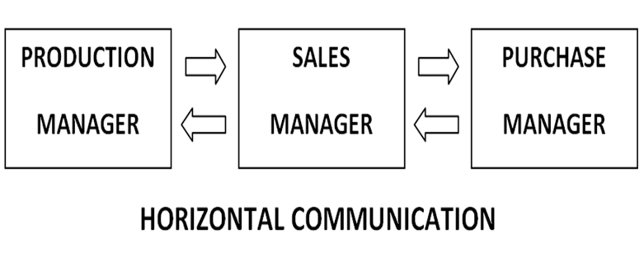
2. Horizontal or Lateral Communication:
It is a communication among people at the parallel or same designation, level and position in the organization. Horizontal communication is the communication that flows laterally within the organization. It involves persons at the same level of the organization. Horizontal communication normally involves coordinating information and allows people with the same or similar rank in an organization to cooperate or collaborate. Some definitions of horizontal communication are as follows: According to Ricky W. Fraffin, “Horizontal communication involves colleagues and peers at the same level of the organization. “

Slide 44

3. Diagonal Communication
It is a Cross-functional communication between employees at different levels of the organizational hierarchy. Diagonal communication is much common in larger organizations with matrix or project- based structures.
It is helpful in overcoming some of the barriers to communication within a business. It reduces the chances of distortion or misinterpretation of message. Diagonal communication also reduces a manager’s communication workload because he doesn’t have to act as an intermediary between his direct reports and other managers.

Slide 45
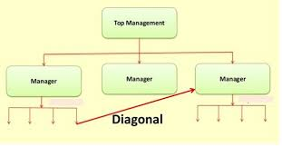
3. Diagonal Communication

Slide 46
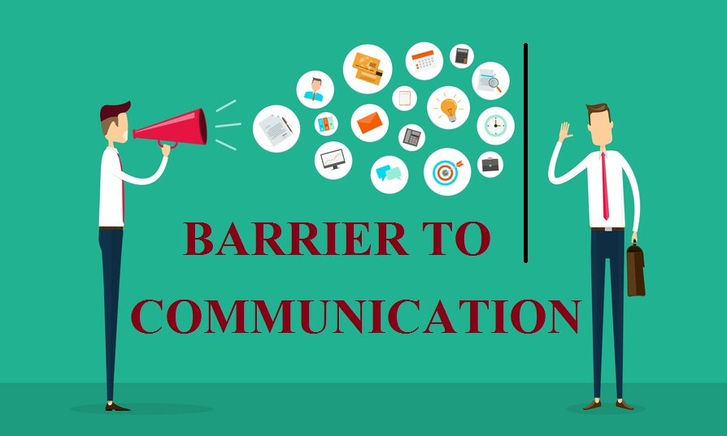
Barriers to Communication (Noise)
Anything that distorts the message sent or received may be called Barrier to Communication. There are several barriers that often distort communication process. For better understanding these may be divided into four categories.

Slide 47
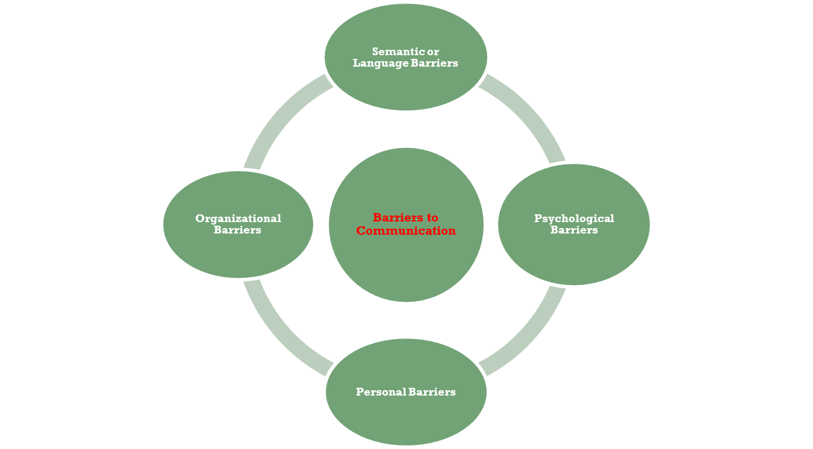
Four Categories of Communication Barriers

Slide 48

1. Semantic or Language Barriers
Unclear message:
If the message is not clear, it may cause barriers to communication.
Faulty translation:
Sometimes Grammatical mistakes can cause wrong expressions, that results into barriers to communication.
Specialists language:
Specialists Language is also a barrier to communication
Unclarified assumption:
Sometimes unclarified assumptions leads to barriers to communication.

Slide 49

2. Psychological Barriers
Difference in perception: If there is a difference in perception of the communicator and the receiver then there will also be misunderstanding between them. Difference in Perception therefore leads to faulty communication.
Closed minds: Closed Mind is another having biased , wayward or whimsical opinion about something.
Inattention: The third factor in psychological barrier is in attention which too leads to faulty communication.
Emotion: Emotion is another psychological barrier which disturbs complete communication.
Distrust of communication: The fifth element is Distrust of Communicator which is also a strong psychological barrier.

Slide 50
3. Personal Barriers
Attitude of Superiors:
Lack of confidence
Insistence of proper channel
Ignoring Communication
Filtering of Information
Lack of Time
Message Overload

Slide 51

4. Organizational Barriers
Status Relationship
One-way Flow
Rules and Regulation
Distance Barriers
Physical Barriers
Mechanical Barriers

Slide 52
7 Cs of Effective Business Communication
The message is said to be effective when the receiver understands the same meaning that the sender intended to convey.
For any communication in business, in order to be effective, it must have seven qualities. These seven attributes are called Seven C’s of Effective Business Communication.
(All these attribute starts with the alphabet ‘C’ so are called 7 C’s)

Slide 53
7 Cs
Correctness
Clarity
Conciseness
Completeness
Consideration
Concreteness
Courtesy

Slide 54
1. Correctness
At the time of encoding, if the encoder has comprehensive knowledge about the decoder of message, it makes the communication an ease. The encoder should know the status, knowledge and educational background of the decoder. Correctness means:
Use the right level of language
Correct use of grammar, spelling and punctuation
Accuracy in stating facts and figures
Result: Correctness in message helps in building confidence.

Slide 55
2. Clarity
Clarity demands the use of simple language and easy sentence structure in composing the message. When there is clarity in presenting ideas, it’s easy for the receiver/decoder to grasp the meaning being conveyed by the sender/encoder.
Result: Clarity makes comprehension easier.

Slide 56
3. Conciseness
A concise message saves time of both the sender and the receiver. Conciseness, in a business message, can be achieved by avoiding wordy expressions and repetition. Using brief and to the point sentences, including relevant material makes the message concise. Achieving conciseness does not mean to loose completeness of message.
Result: Conciseness saves time.

Slide 57
4. Completeness
By completeness means the message must bear all the necessary information to bring the response you desire. The sender should answer all the questions and with facts and figures. and when desirable, go for extra details.
Result: Completeness brings the desired response.

Slide 58
5. Consideration
Consideration demands to put oneself in the place of receiver while composing a message. It refers to the use of You attitude, emphases positive pleasant facts, visualizing reader’s problems, desires, emotions and his response.
Result: Consideration creates understanding of human nature.

Slide 59
6. Concreteness
Being definite, vivid and specific rather than vague, obscure and general leads to concreteness of the message. Facts and figures being presented in the message should be specific.
Result: Concreteness reinforces confidence.

Slide 60
7. Courtesy
In business, almost everything starts and ends in courtesy. Courtesy means not only thinking about receiver but also valuing his feelings. Much can be achieved by using polite words and gestures, being appreciative, thoughtful, tactful, and showing respect to the receiver. Courtesy builds goodwill.
Result: Courtesy strengthen relations.

Slide 61

Code & Content
.

Slide 62

Code and Content in communication skills
Any human communication system involves the production of a message by someone, and the receipt of that message by someone else.
To encode a message, one must possess the necessary encoding skills.

Slide 63
1. Languages are codes :
i. A code may be defined as any group of symbols that can be structured in a way that is meaningful to another person.
ii. The English language, like any other language, is a code which contains elements that are arranged in a meaningful order.
iii. A code has a group of elements (vocabulary) and a set of procedures for combining these elements meaningfully (syntax).

Slide 64
2. Content :
i. The message content, i.e., the message that is selected by the source to express its purpose.
ii. Content, like codes, has both element and structure. When more than one piece of information is to be presented, they should have some order or structure.
iii. An individual may sometimes be identified by his characteristic way of structuring messages. This is because the individual communicates in a way that is distinctive to him.
iv. An individual uses a distinctive way or method, which has become
his habit by constant use.

Slide 65
Stimulus and Response in communication skills
A stimulus is a thing that a person can receive through one of his senses. In fact, it is a thing that can produce a sensation
2. A response is a thing that an individual does as a reaction to the stimulus.
3. Stimulus and response are the two terms that are frequently used in
any discussion on the communication process.
4. Stimulus and response are ultimately connected with the whole learning process.
5. The communication objective of the source is to bring about a change in the behaviour of the receiver.

Slide 66
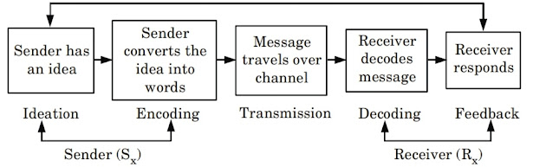

Slide 67

Process of technical communication consists of five stages :
1. Ideation :
1. It begins with ideation which refers to the formation of idea or selection of message. It consists of the ‘what’ of communication and is concerned with the content of the specific message to be presented.
2. The scope of ideation is generally determined by the sender’s :
a. Knowledge
b. Experience
c. Abilities
d. Purpose of communication
e. Context of the communicative situation

Slide 68

2. Encoding :
It is the process of changing the information into some form of logical and coded message. It involves :
a. Selecting a language : It is essential for effective coding, verbal messages need a common language code, which can be easily decoded by the receiver.
b. Selecting an appropriate communication form : It form largely depends on the sender-receiver relationship, need and purpose of the communication.
c. Selecting a medium of communication : It involves making the right choice out of many available options. There are three

Slide 69

3. Transmission :
i. It refers to the flow of message over the chosen channel.
ii. It involves choosing the :
a. Proper time (When to communicate)
b. Proper place (Where to communicate)
c. Proper way (How to communicate)

Slide 70

4. Decoding :
Decoding is the process of converting a message into thoughts.
ii. The process of decoding involves interpretation and analysis of a message.
iii. Decoding involves reading and understanding of the written communication, listening and understanding of the oral communication.

Slide 71

5. Feedback / Response :
i. Response is the last stage in the communication process.
ii. It is the action or reaction of the receiver to the message.
iii. Response is the key to communication. It helps the sender to know that the message was received and understood.

Slide 72
Stimulus and Response of Communication Skills
Stimulus and response are the two terms that are frequently used in any discussion on the communication process. A ‘stimulus’ is anything that a person can receive through one of his senses.
In fact, it is anything that can produce a sensation. And a ‘response’ is anything that an individual does as a reaction to the stimulus.

Slide 73
These two terms, stimulus and response, are ultimately connected with the whole learning process. The communication objective of the source is to bring about a change in the behavior of the receiver. The whole communication process consists of the following:
1. The sender—the source of the message
2. The encoding process
3. The channel
4. The decoding process
5. The receiver—the person who receives the message
6. Feedback

Slide 74
Communication Process Cycle
Encoding Process
Decoding Process
.
Sender
Receiver
Message
Channel
Feedback

Slide 75

Pronunciation Etiquettes
A. Vowel sounds
B. Consonant sounds
C. Syllables & Tone
D. Intonation: Rising tone; Falling Tone

Slide 76
VOWEL & CONSONANT SOUNDS
1. Vowels: The vowel is a sound in the production of which the air stream does not meet an obstruction and there is no noise component. In British English, there are 20 vowel sounds divided into 5 long vowels, 7 short vowels and 8 diphthongs (gliding vowel sounds, which are a composed of a combination of two short vowel sounds).
2. Consonants: Consonants are defined phonetically as sounds made by a closure or narrowing in the vocal tract so that the airflow is either completely blocked or restricted with an audible friction. There are 24 consonant sounds.

Slide 77
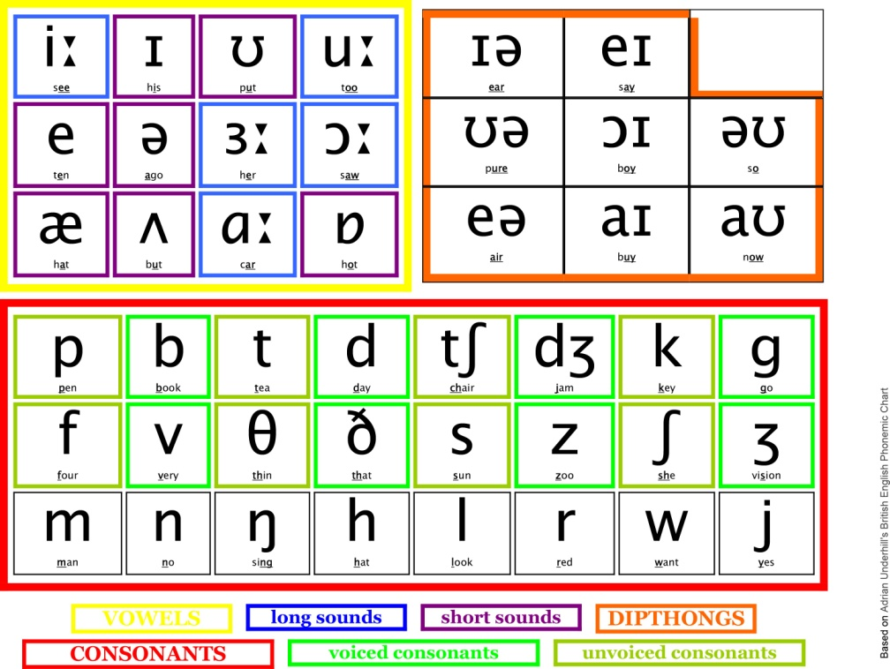
IPA CHART
The International Phonetic Alphabet (IPA) is an alphabetic system of phonetic notation:

Slide 78
SYLLABLE
A unit of pronunciation having one vowel sound, with or without surrounding consonants, forming the whole word or a part of a word id called syllable.
For example:
Cat has one syllable (words of one syllable are monosyllabic)
Water has two syllables ((wa / ter) this word is Disyllabic)
Computer has three syllables ((com / pu / ter) this word is Polysyllabic)
Category has four syllables (cat / e / gor / y) so on.

Slide 79
SYLLABLE
A syllable is the sound of a vowel (A, E, I, O, U) that is created when pronouncing the letters A, E, I, O, U, or Y. The letter "Y" is a vowel only if it creates an A, E, I, O, or U sound. For example: fry, try, cry, & dry.
The number of times, you hear a vowel is the number of syllables in a word. When two (or more) Vowel are next to each other, the number of syllables depends on the number of vowels. For example: free (1 syllable), eat (1 syllable), & bio (2 syllables)
In case of the words end with "le" or "les“, this is a syllable if the letter before the "le" is a consonant.
If a vowel is silent, it is not counted as a syllable for example: fire (1 syllable)

Slide 80

Tone
Tone is the overall behavior of pitch and pitch is frequency of vibration of vocal cords. Tone is the attitude or how somebody sounds whereas intonation is the rise and fall of voice, sound or tone of certain words within a sentence.
Intonation is about how we say things, rather than what we say. Without intonation, its impossible to understand the expressions and thoughts that go with words. Listen to somebody speaking without paying attention to the words: the melody you hear is the intonation. Intonation is a term used to refer to the distinctive use of different patterns of pitch that carry meaningful information.

Slide 81
Intonation
According to Philip Carr, ‘The kinds of pitch modulation which are found in whole utterances.
It (intonation) can highlight intended elements in an utterance, to bundle words together into information chunks, & to convey speaker’s attitude to what he/she is saying.’

Slide 82
Rising & Falling Intonation
In many descriptions of English, the following intonation patterns are distinguished: Rising Intonation means the pitch of the voice rises over time. Falling Intonation means that the pitch falls with time. Dipping or Fall-rise, where Intonation falls and then rises.
A rising intonation pattern would simply be a rise in the human voice; it would be a change in pitch; a glide in the pitch of our voice upwards. when we’re asking questions or listing , for instance: ‘would you like a cup of tea?’ and ‘I’d like some eggs, some milk, some cheese and some bread.’ etc.
A falling intonation or downward intonation pattern, would simply mean that the pitch of the voice drops down. So I would say, for instance, if I’m making a statement, command or exclamation: ‘that’s wonderful’, 'put that down!‘, 'go over there‘ and 'stand against the wall’ etc.

Slide 83
Pronunciation Etiquettes
Ways to make your Pronunciation effective:
1. Learn to listen and focus on the pronunciation of other people.
2. Pay attention to your tongue & notice how your mouth and lips move.
3. Learn Syllable & break words down into sounds.
4. Add proper stress to sounds and words.
5. Ask yourself which dialect of English you want to learn.
6. Write out difficult words by their sounds.
7. Write down what you hear.
8. Practice pronunciation with tongue twisters.
9. Record yourself to find your problems.
10. Practice with someone (in fact anyone).
11. Speak as much as you can.

Slide 84

Keep Learning on …
Thanks

